Slide 1


Slide 2

Java OOP and Data Structures with Introduction to Secure Coding Dr. Ziping Liu
Chapter 11 JavaFX: Developing GUI-Based Applications

Slide 3
https://he.kendallhunt.com/product/java-oop-and-data-structures-introduction-secure-coding
Chapter 11 JavaFX: Developing GUI-Based Applications

Slide 4

Chapter Outlines
Background on JavaFX
Reactive JavaFX application
Creating a layered application layout
Adding event handling
Switching between multiple Scenes
Navigating multiple Stages
Working with data in JavaFX

Slide 5
11.1 Background on JavaFX
Develop GUI-based applications: design layouts, allow users to interact with UI controls, and handle events when the user performs actions on those UI controls.
JavaFX: contains packages for graphics and media elements to create applications

Slide 6
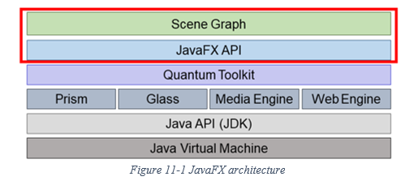
11.1 Background on JavaFX
JavaFX is organized in layers
scene graph: includes all the application components—such as buttons, text boxes, and the application container—organized as sets of parent/child relationships (i.e., buttons are nested within the overall application container; text or icons may be nested within each button).
JavaFX API: can be used to build the scene graph and program the application.
The JavaFX API is built on top of various “engines,” such as Prism (for graphics rendering), Glass (for creating windows), the media engine (to process audio and visual elements), and the web engine (to support webpages). These engines are made available to JavaFX through a layer called the Quantum Toolkit.

Slide 7
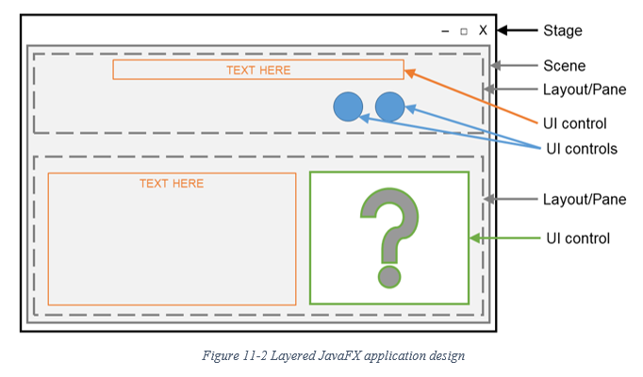
11.2 Designing a Simple Reactive Application
JavaFX applications are built in layers: the Stage, a Scene, one or more layout container(s) or Pane(s), and various UI controls—called “nodes.”

Slide 8
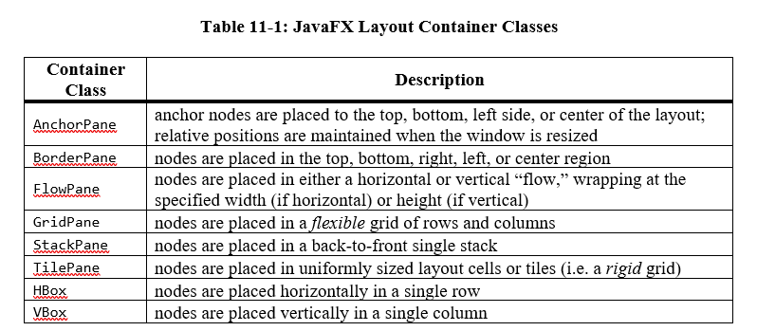
11.2 Designing a Simple Reactive Application

Slide 9
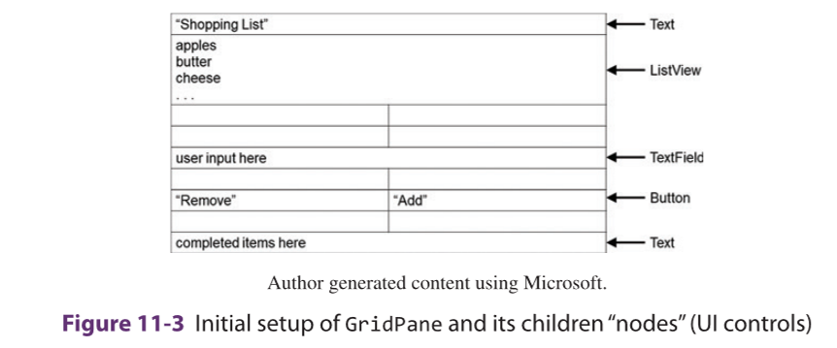
11.2 Designing a Simple Reactive Application

Slide 10
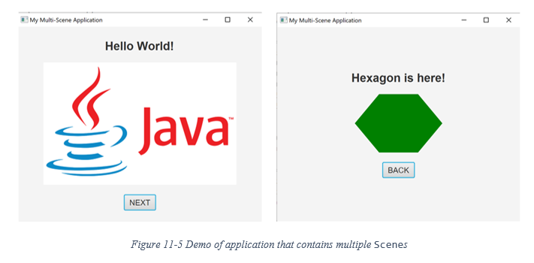
11.3 Switching between Multiple Scenes
In a multi-Scene application, there is only one window, but users can navigate to different screens (or Scenes) upon different ActionEvents.

Slide 11
11.4 Navigating Multiple Stages
JavaFX also allows an application to display multiple windows using multiple Stages. JavaFX Stage can represent modeless and modal windows. Modalities can be applied to a Stage to configure modal windows through the initModality(Modality) method. There are three types of Modalities:
Modality.NONE: The Stage will not block input to any other top-level Stage while it is shown.
Modality.WINDOW_MODAL: The Stage will block input to other top-level Stages in the application.
Modality.APPLICATION_MODAL: The Stage will not allow user input to any other Stage of the application until this one is closed.

Slide 12
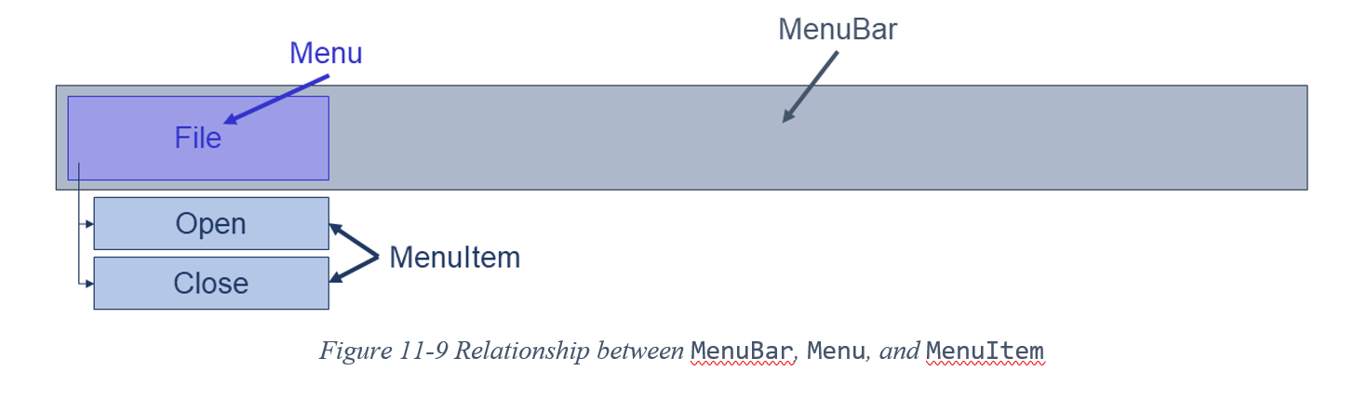
11.5 Working with Data in JavaFX

Slide 13


Slide 14


Slide 15
Which National Park is it?
Answer: Banff National Park

